Slide 1

ECE 382V: QUANTUM COMPUTING SYSTEMS:
A SOFTWARE/ ARCHITECTURE PERSPECTIVE
Measurement error MITIGATION
POULAMI DAS
ECE, The University of Texas at Austin

Slide 2
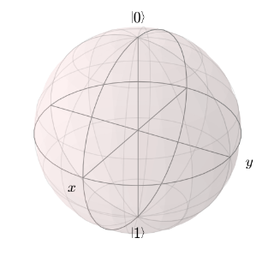
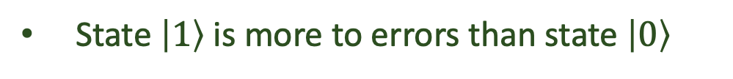
Recap: Quantum Measurements Are Erroneous
Quantum measurements produce incorrect ‘classical’ outcomes
1
1
Error
0
Error-rates typically in the range of 1-4 %
30%
50%
Quantum Measurement
1
0
State $\left|1\right\rangle$ is more to errors than state $\left|0\right\rangle$
0
70%
50%
Lower measurement (or readout) errors are desirable

Slide 3
Why Are Measurements Error-Prone?
Example of a measurement operation on a superconducting qubit
0
1
0
1
Measure
Software
Frequency shift is sensitive to noise
Discriminator
ADC
Hardware
Thermal noise
Amplifier
300 K
Long latency
SNR+
3-4 K
Resonator
Inaccurate classification
20 mK

Slide 4
Measurement Error-Rates Really High
Quantum Volume
We obtain an incorrect outcome even if one of the measurement operations fail

Slide 5
Simultaneous Measurements More Vulnerable
Crosstalk
Isolated
Multiple
Measurement crosstalk increases with program size

Slide 6
How To Reduce Measurement Errors?
Device-level techniques for reducing measurement errors
Can we transform the circuit such that we measure $\left|0\right\rangle$ most of the time?
q0
X
M
q0
X
X
M
How do we know what is the output state of a program?
q1
X
M
q1
X
X
M
Measurement errors are relatively easier to correct using post-processing
q0
M
2%
It incurs huge overheads (quantum + classical)
Prob.
Prob.
q0
X
M
4%
0
1
0
1
Outcomes
Outcomes
More accurate state classification
We will cover some of these measurement error mitigation schemes

Slide 7
Approach of STATE Transformation
Why quantum computing? What topics will be covered? What are the requirements and expected outcomes?

Slide 8
Measurement Errors Have Bias
Correct Answer
0
1
84%
Measure
Probability
0
0
0
0
0
2
All zero state
16%
3
4
ibmqx4
Probability
1
1
1
1
1
Measure
62%
All one state
38%
Invert
Measure
78%
1
1
1
1
1
Probability
22%
All one state
Goal: Flip and measure qubits in a less vulnerable state

Slide 9
Challenge: To Invert Or Not To Invert?
Correct Answer
Probability
1
1
1
1
1
Measure
62%
38%
Invert
Measure
78%
1
1
1
1
1
Probability
22%
Invert
Measure
58%
0
0
0
0
0
Probability
42%
Flipping and measuring must be done with caution because we do not know the correct output

Slide 10



Measurement Error Mitigation Via State Transformation
$$\frac{N}{2}$$
trials
Measure
$$N$$
trials
Invert
Measure
$$\frac{N}{2}$$
trials
Swamit Tannu et al. “Mitigating Measurement Errors in Quantum Computers by Exploiting State-Dependent Bias”, MICRO 2019
More on generalization and bias estimation for efficient inversion in the paper

Slide 11
Characterization + POST-Processing
Why quantum computing? What topics will be covered? What are the requirements and expected outcomes?

Slide 12
Modeling Measurement Errors
Model measurement error as an operator that maps an n-bit outcome (say X) into another n-bit outcome (say Y) with some probability ‘p’
n-bit
Program
Example:
X
M
n-bit string
outcome
q0
q1
+
M
Produces 01 instead of 11
N= 2^{n} possible
outcomes
We can correct the measurement error using classical post-processing by re-mapping the incorrect n-bit outcome (Y) into the correct n-bit outcome (X) using probability ‘p’
How do we determine the probability ‘p’? How many Xs? How many Ys?

Slide 13
How Many Correct <-> Incorrect Mappings?
An outcome or bitstring maps to itself when there is no measurement error
An outcome maps to any one of the remaining (N-1) outcomes if measurement error occurs
The sum of probabilities of mapping to itself and mapping to all other outcomes must be 1
…
N= 2^{n} possible
outcomes
How do we best represent this?

Slide 14


Formulation Of A Noise Matrix
2^{n}
2^{n} x 2^{n} matrix
Row index corresponds to expected outcome/state
Column index corresponds to outcome/state after measurement
Entry[row][col] -> probability of obtaining the outcome corresponding to col if the expected outcome corresponds to row
2^{n}
Example:
00
01
10
11
Probability that state 00 is correctly measured as 00
00
01
Noise Matrix (M)
10
Probability that state 11 is incorrectly measured as 00
11
How can we prepare the noise matrix?

Slide 15
The Inverse Noise Matrix
…
N= 2^{n} possible
outcomes
When do we observe a certain state after measurement?
…
N= 2^{n} possible
outcomes
Multiplying with the inverse noise matrix rectifies the output distribution

Slide 16

How Do We Prepare The Noise Matrix?
Prepare an initial state (say |00⟩ state)
00
01
10
11
00
01
Measure the qubits
10
11
Repeat state preparation and measurement for a few thousand trials
q0
M
q0
X
M
q1
M
q1
M
Obtain probability distribution which corresponds to the row for the initial state
q0
M
q0
X
M
Repeat for other states (|01⟩ , |10⟩ , |11⟩)
q1
X
M
q1
X
M
Characterizing all possible basis states enables us to compute the noise matrix

Slide 17

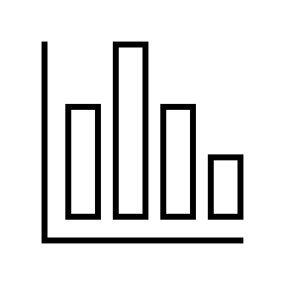
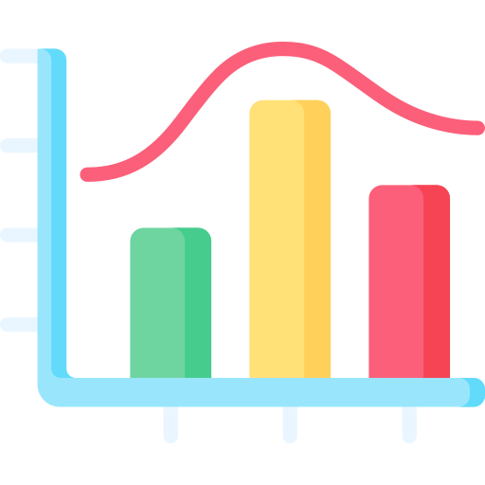
Matrix-Based Measurement Error Mitigation
Noise Matrix
Inverse Noise Matrix
Characterize
n-bit
Program
Post-process
Run Program
Noisy distribution
Measurement error-mitigated distribution
What are the drawbacks of this technique (complete measurement error mitigation)?

Slide 18
Matrix-Based Measurement Error Mitigation Drawbacks
Who characterizes?
Noise Matrix
Inverse Noise Matrix
How frequently?
Number of circuits?
Characterize
Classical overheads?
n-bit
Program
Post-process
Run Program
Noisy distribution
Measurement error-mitigated distribution
How do we reduce these overheads?

Slide 19
Reducing Complexity Of Matrix-Based Error Mitigation
Overheads result from running an exponentially large number of characterization circuits and using an exponentially large inverse noise matrix
2^{n}
possible states
If n = 10, 1024 circuits, 1024 x 1024 matrix
n-bit
Program
…
Complete or Global Correlation
n qubits
M x 2^{k}
possible states
If n = 10, k = 2,
5 x 4 = 20 circuits,
5 of 4 x 4 matrices
n-bit
Program
…
Localized Correlation
n qubits
M groups of k qubits
This approach is known as tensored error mitigation. What are the drawbacks?

Slide 20
Selective Global Characterization
Tensored error mitigation trades-off accuracy (does not capture correlation in measurement errors between qubit groups) for reduced complexity
n-bit
Program
Post-process
Run Program
Noisy distribution
Measurement error-mitigated distribution
Characterize only the basis states observed in noisy distribution
Noise Matrix
Inverse Noise Matrix
Characterize
This approach captures correlated measurement errors while reducing complexity

Slide 21
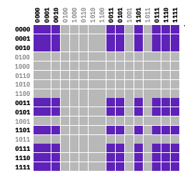
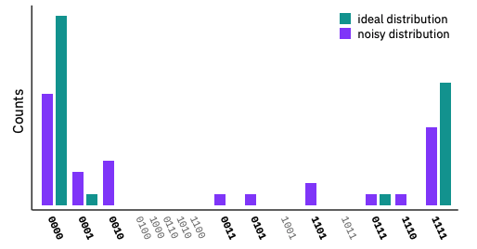
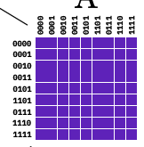
Example Of Selective Global Characterization
Program output distribution
Global Noise Matrix
Reduced Matrix
https://arxiv.org/pdf/2108.12518.pdf
What are the drawbacks of this technique?

Slide 22
FEWER Measurements + Recompilation
Why quantum computing? What topics will be covered? What are the requirements and expected outcomes?

Slide 23

Fewer Measurement Reduce Readout Crosstalk
Measure fewer qubits and Reconstruct Distribution
Ideal
X
Are high-fidelity circuits with partial measurements alone sufficient?

Slide 24

Need For Correlation
Ideal
Correlation?
X
Ideally, we want both correlation and high fidelity

Slide 25
JigSaw
Recompile
Recompile
. . .
Original program
Circuits with Partial Measurements (CPM)
NISQ Device
NISQ Device
Bayesian Updates
Global-Mode
(50% of Trials)
Subset-Mode
(50% of Trials)
JigSaw provides both correlation and high fidelity

Slide 26
Performance Of JigSaw
Average: 3.1x
Best-Case: 8.4x
How does recompilation help? How about combining with other methods?

Slide 27
Performance Of JigSaw
3.25x higher probability of success
Avg. 2.x Max: 7.8x with recompilation
Can be combined with other methods
EDM: Ensemble of Diverse Mappings [Prior work that used multiple mappings to run a program]
JigSaw combined with other techniques is even more effective

Slide 28
Improved STATE Classification
Why quantum computing? What topics will be covered? What are the requirements and expected outcomes?

Slide 29
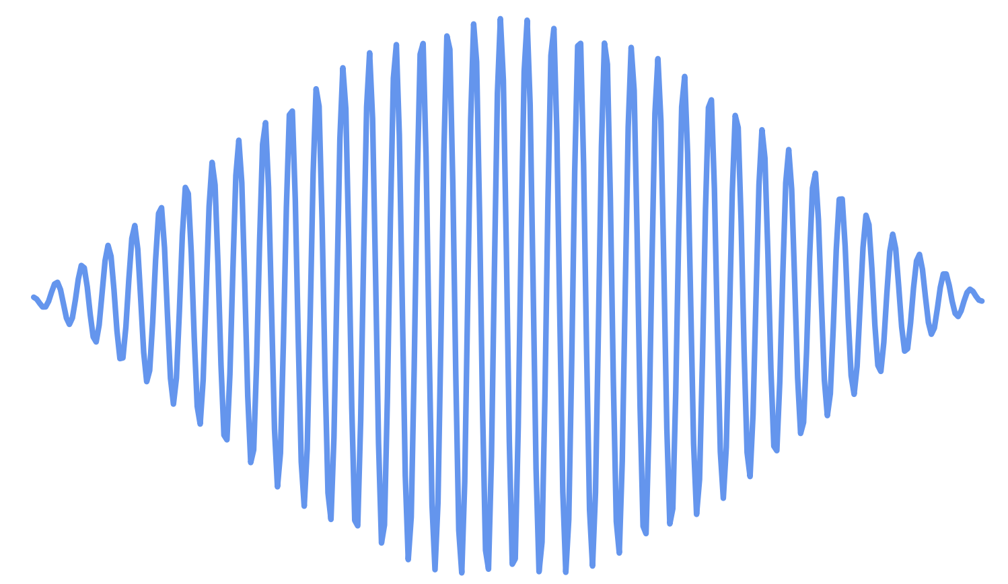
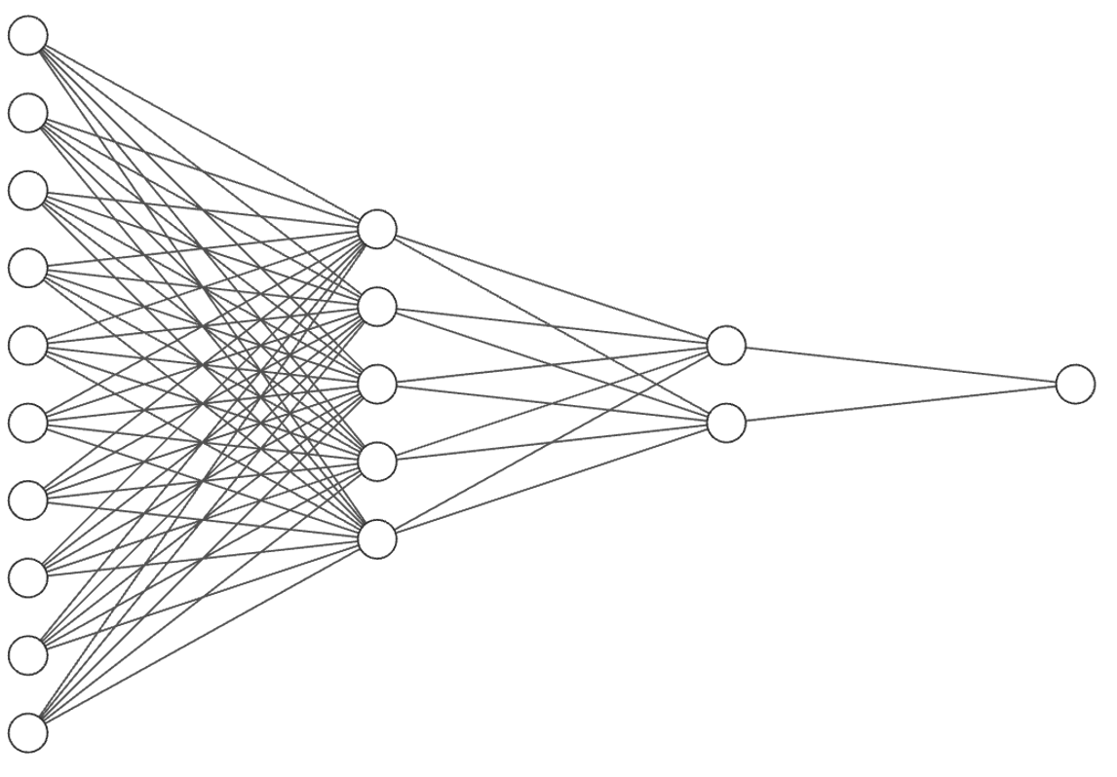
Measurement Output Classification
Readout signal
A state-dependent readout signal is acquired from the qubits that is digitized by an Analog-to-Digital Converter.
This digitized data is used for state classification.
Qubits
ADC
Qubit state classifier
0/1
Time
dependent
signal
1000 sample buffer
Multiplexed readout
Signal
(5 qubits)
ADC
0 to 31
>½ million parameters!
State-Of-The-Art Classifier Design
1Lienhard, Benjamin, et al. "Deep-neural-network discrimination of multiplexed superconducting-qubit states." Physical Review Applied 17.1 (2022): 014024.
Qubit readout translates an analog signal into digital information

Slide 30
What About Implementation Of The NN Classifier?
1000 sample buffer
Multiplexed readout
Signal
(5 qubits)
ADC
0 - 31
>½ million parameters!
But…..
Up to 25% reduction in state assignment error rate compared to contemporary classifiers.
Up to 10x reduction in readout crosstalk.
High hardware complexity (>100% LUT utilization on Xilinx MPSoCs)
Slow if implemented in software
Hardware complexity of NN classifiers limit their adoption

Slide 31
Understanding Measurement Classifier Space
Hardware classifiers
Software classifiers
Retain crosstalk mitigation advantages offered by neural networks.
Reduce hardware complexity.
IBM hardware classifier
Readout Error
Large FNN Classifier
Classification latency /
Hardware complexity
Ideally, we want the benefits of NN at lower complexity as IBM’s classifier

Slide 32
Visualizing Readout Process
Inphase (I)
Qubits
ADC
Quadrature (Q)
The readout signal is received from the qubits is a continuous time signal of duration > 100ns.
The readout signal is split into two channels – Inphase (I) and Quadrature (Q).

Slide 33
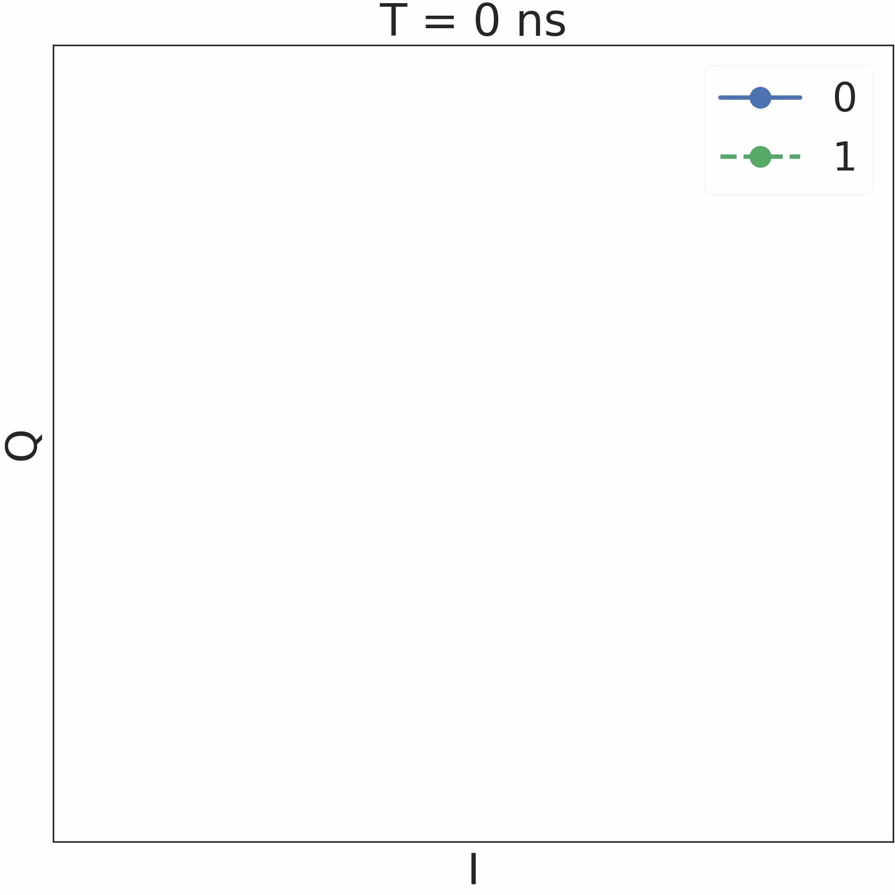
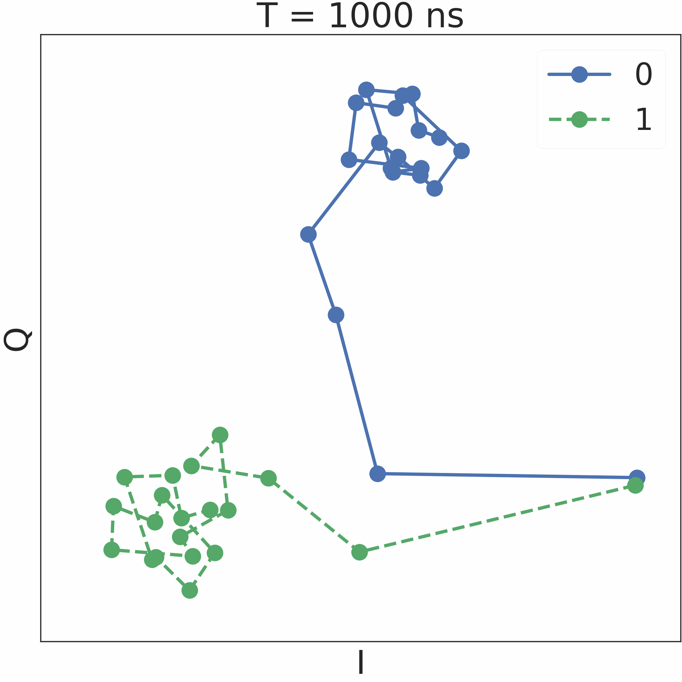
Visualizing Readout Process
Inphase (I)
Qubits
ADC
Quadrature (Q)
The readout signal is received from the qubits is a continuous time signal of duration > 100ns.
The readout signal is split into two channels – Inphase (I) and Quadrature (Q).

Slide 34
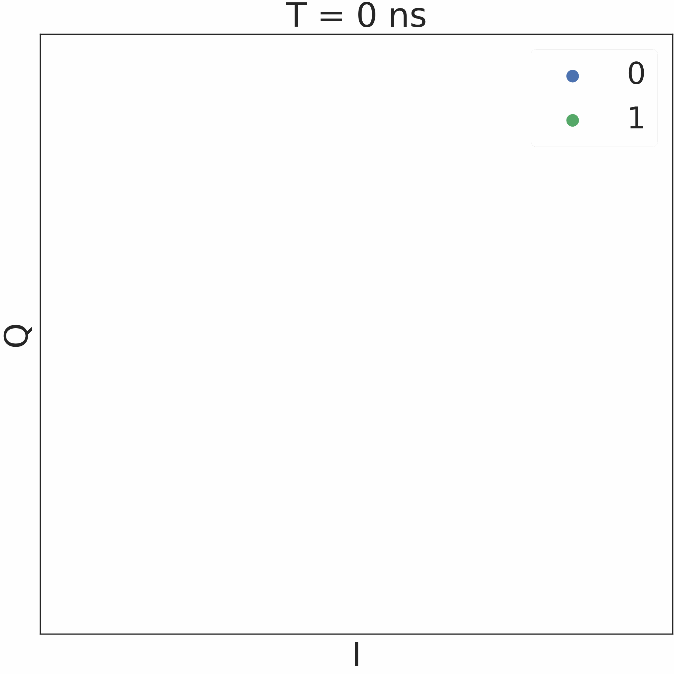
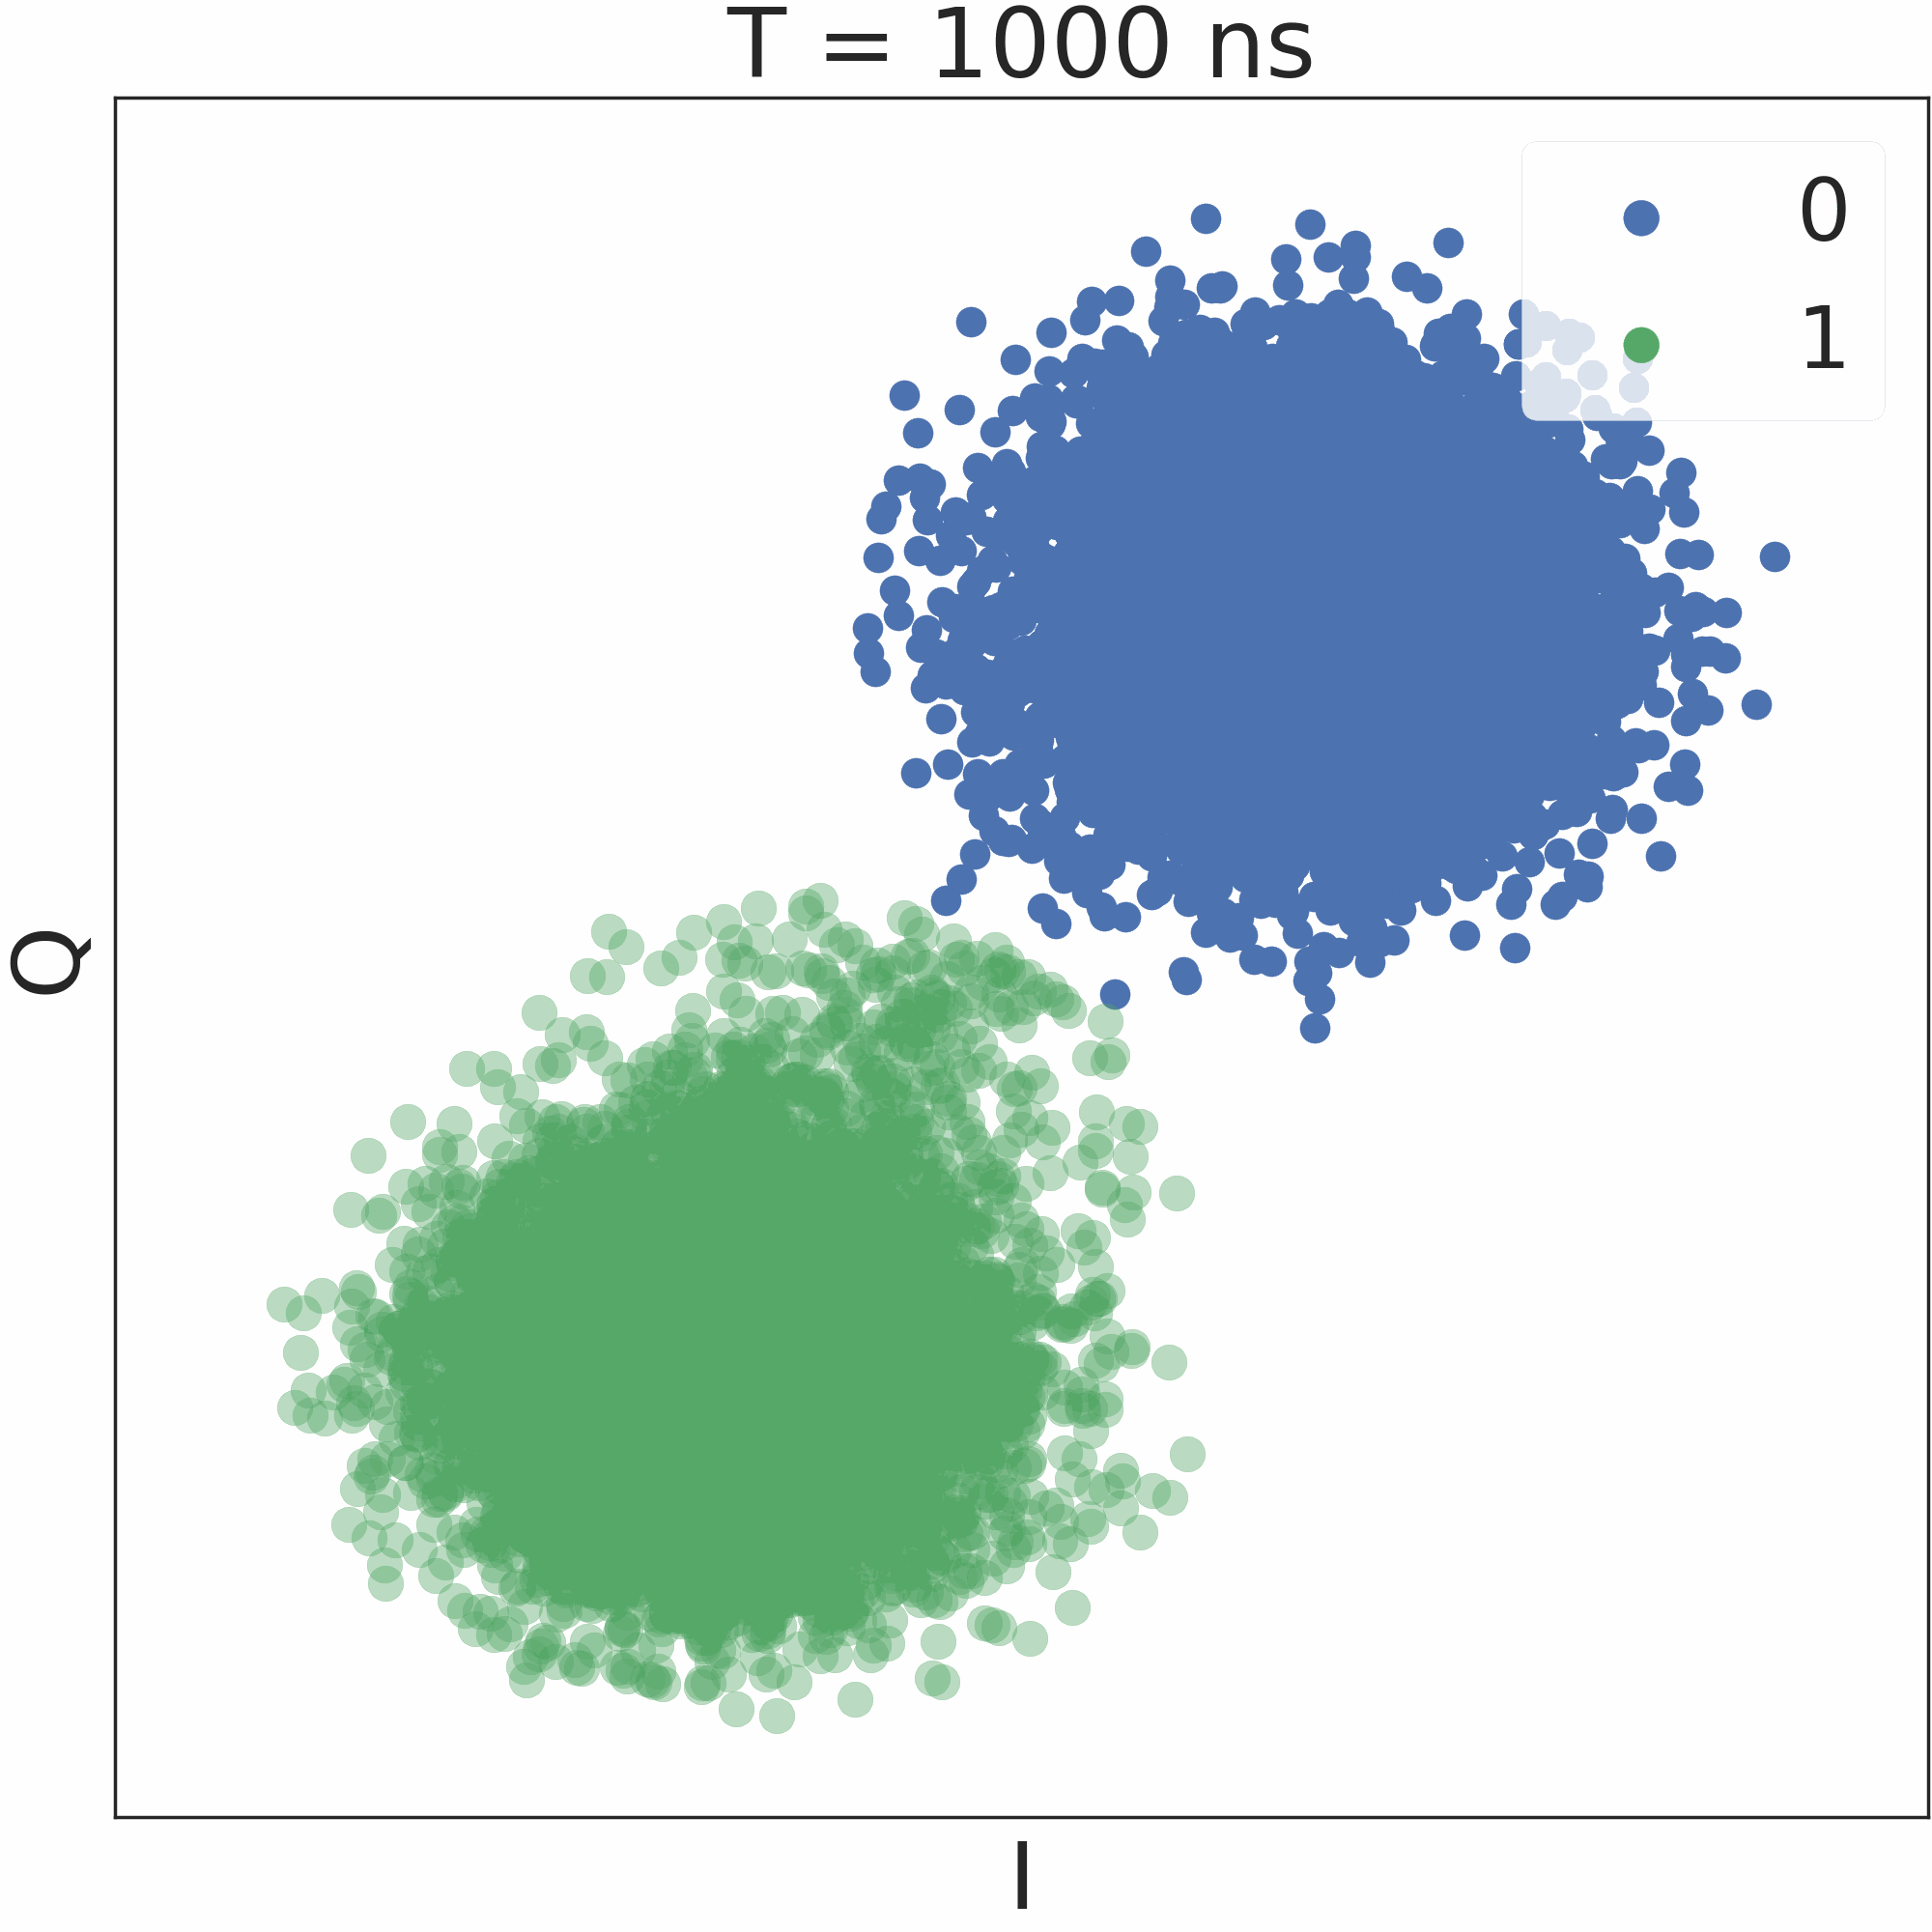
Visualizing Readout Process
1000s of shots
I
Qubits
ADC
Filter
Classifier
Q
The readout signal is received from the qubits is a continuous time signal of duration > 100ns.
The readout signal is split into two channels – Inphase (I) and Quadrature (Q).
Filtering reduces the dimension of the input signal – usually an averaging filter.

Slide 35
Reality Of Readout Process
(Reality)
Qubits prepared in state ‘1’ relax back to the ground state during readout
Qubits relax to their ground state during the long-latency measurement process

Slide 36
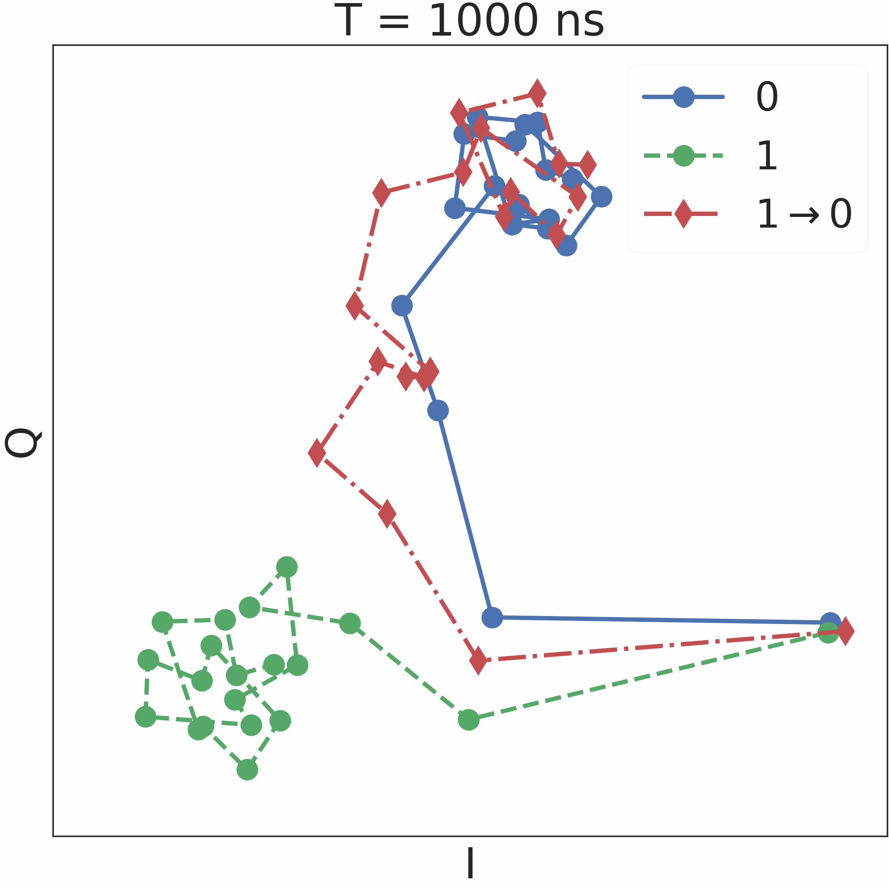
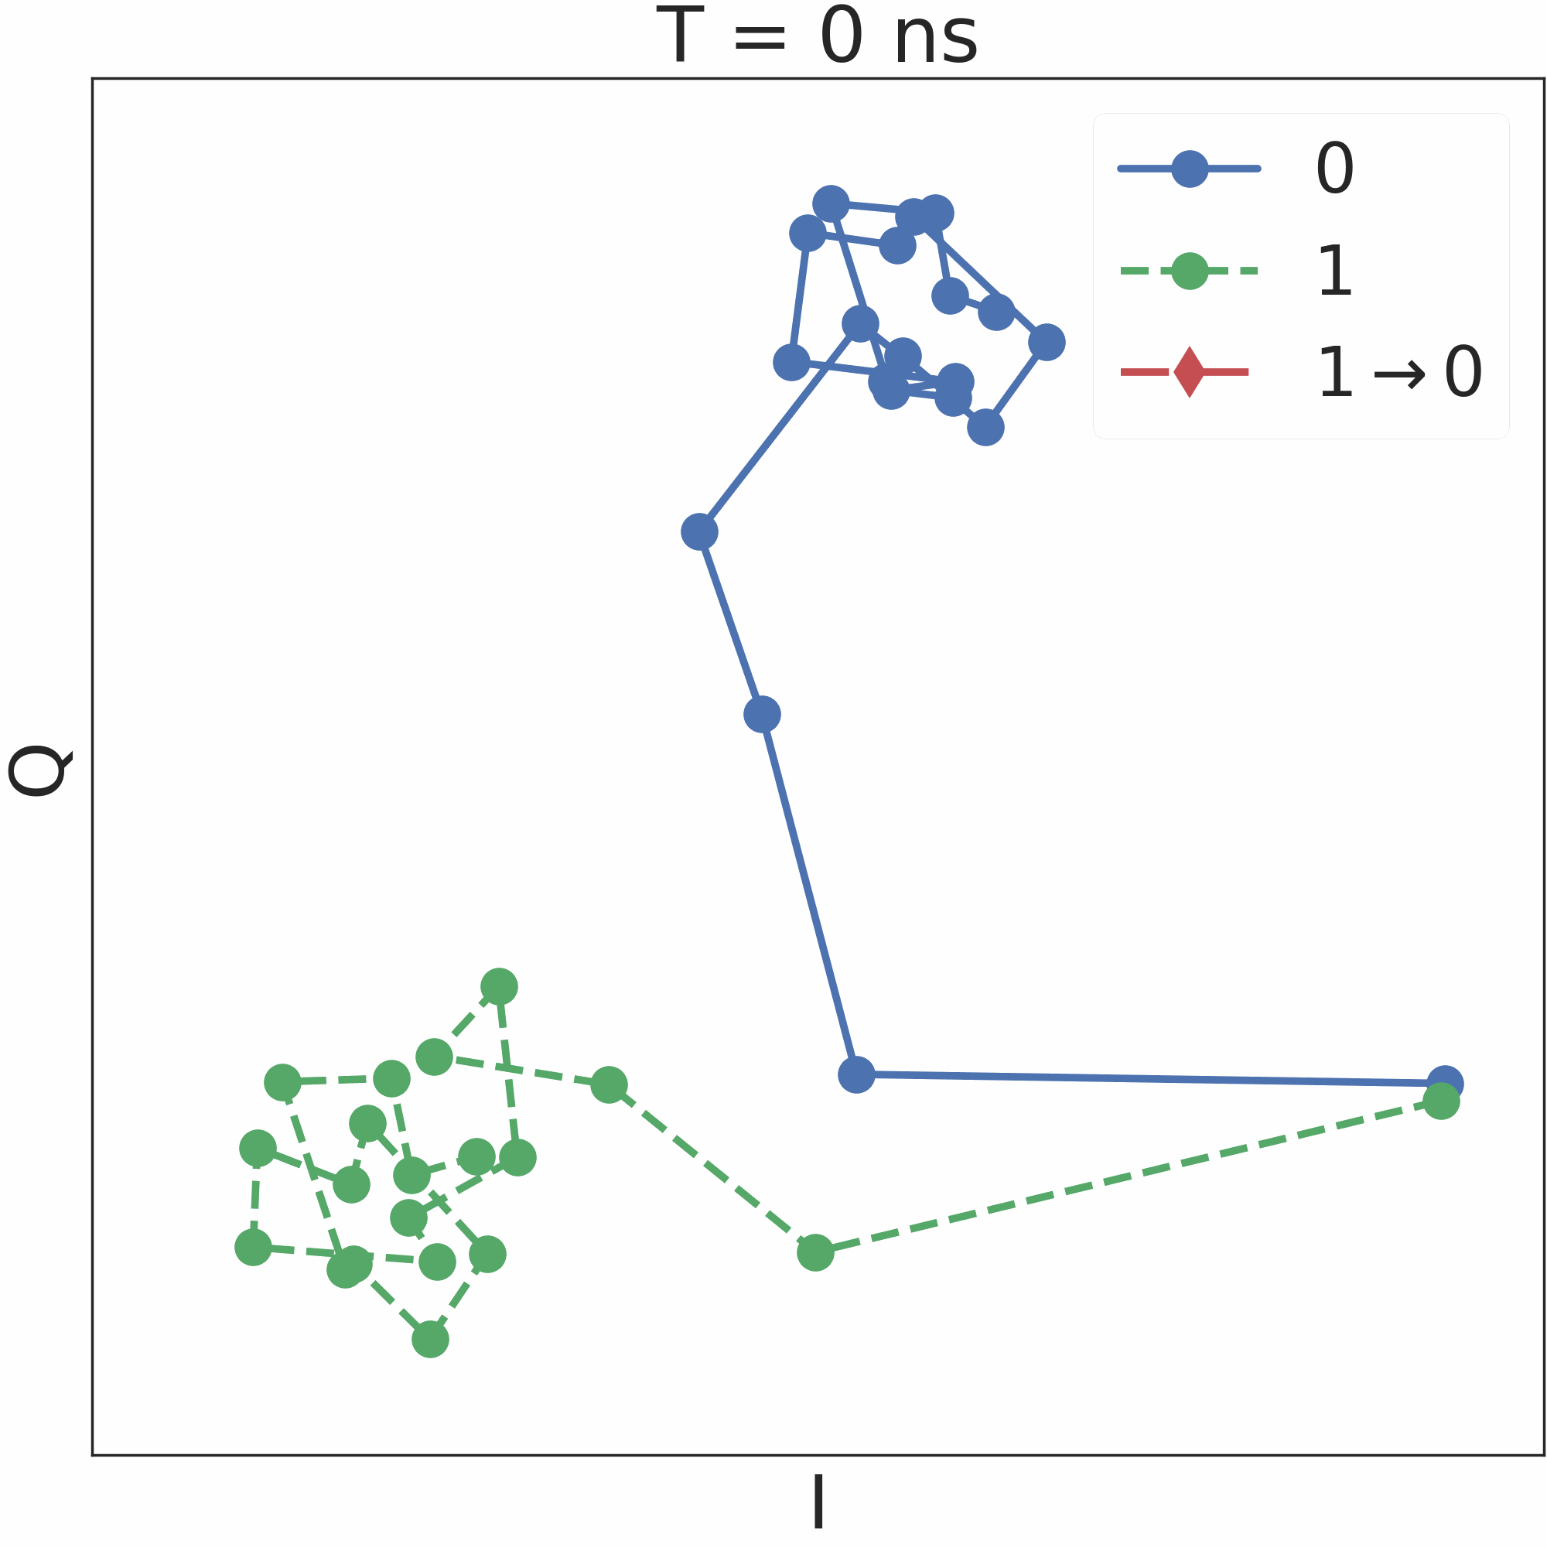
Detecting Relaxations
Traces corresponding to relaxations are distinct, can be detected using template matching

Slide 37
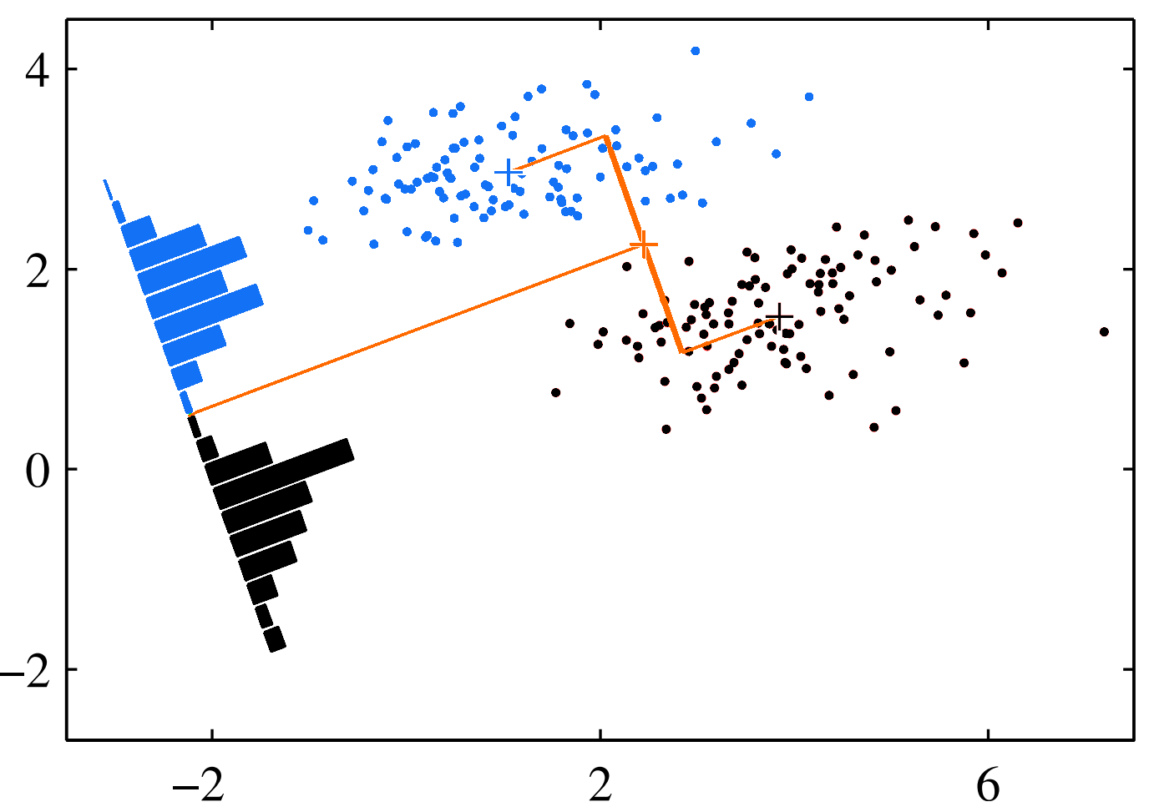
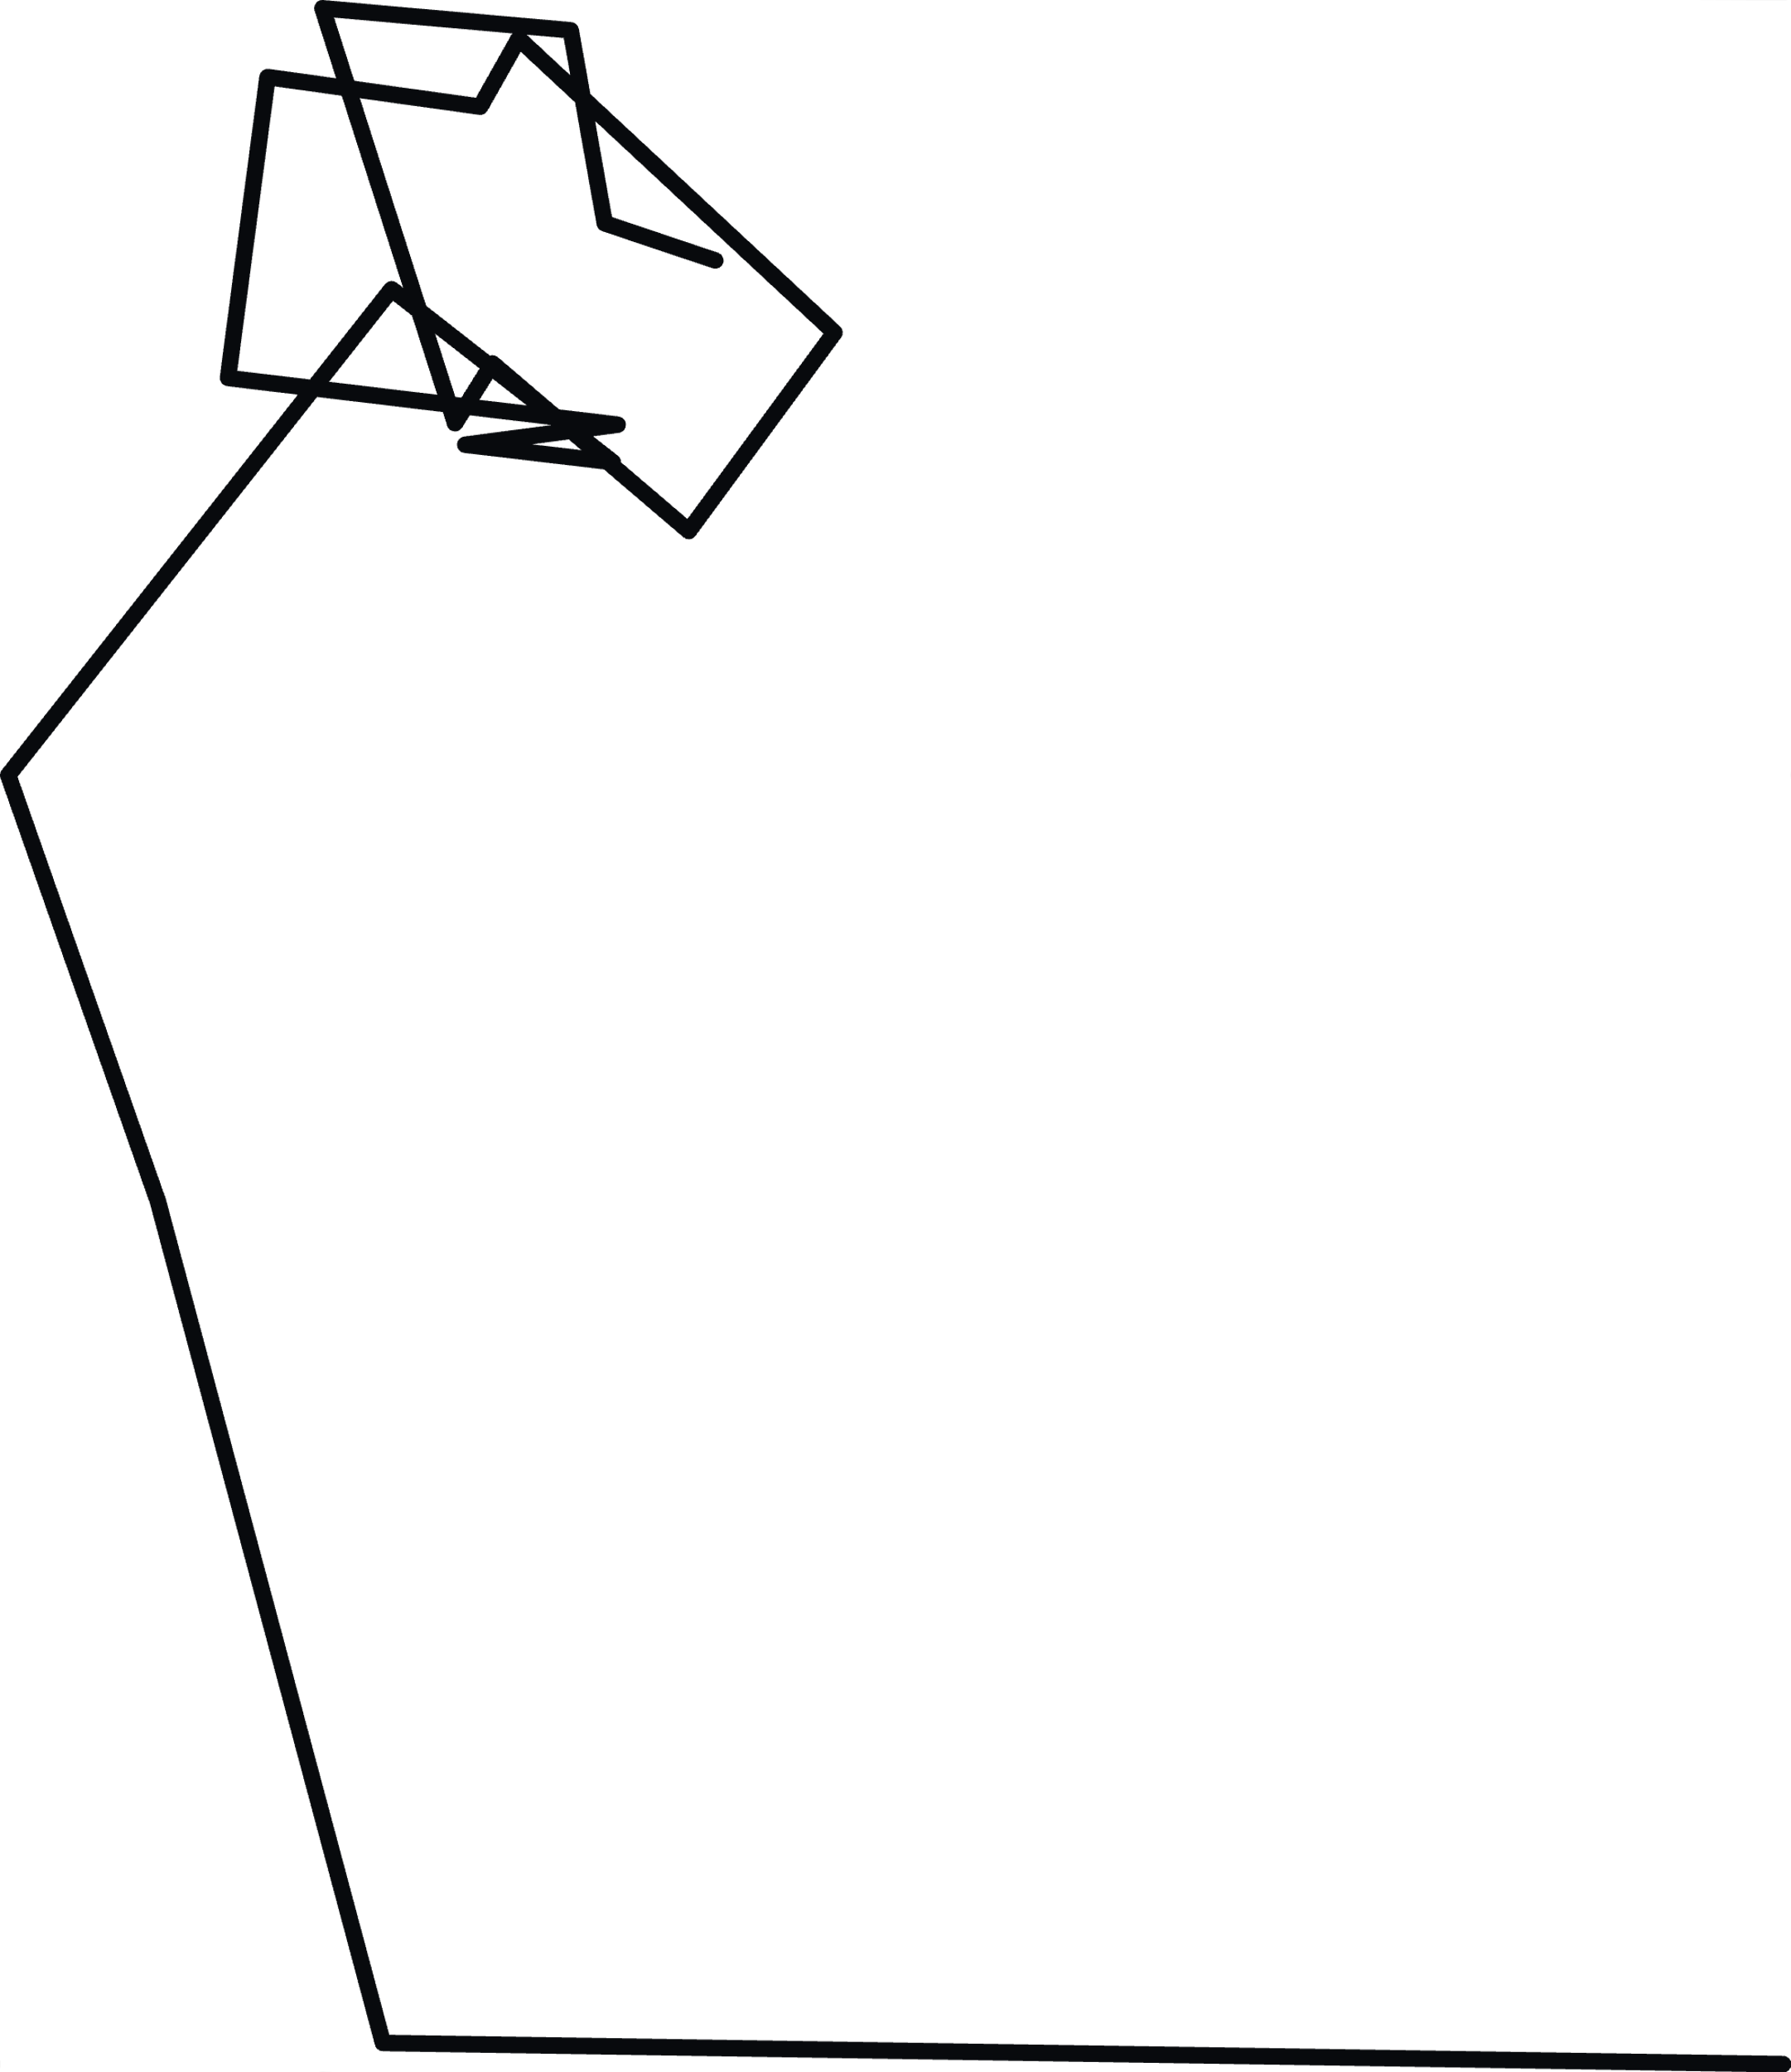
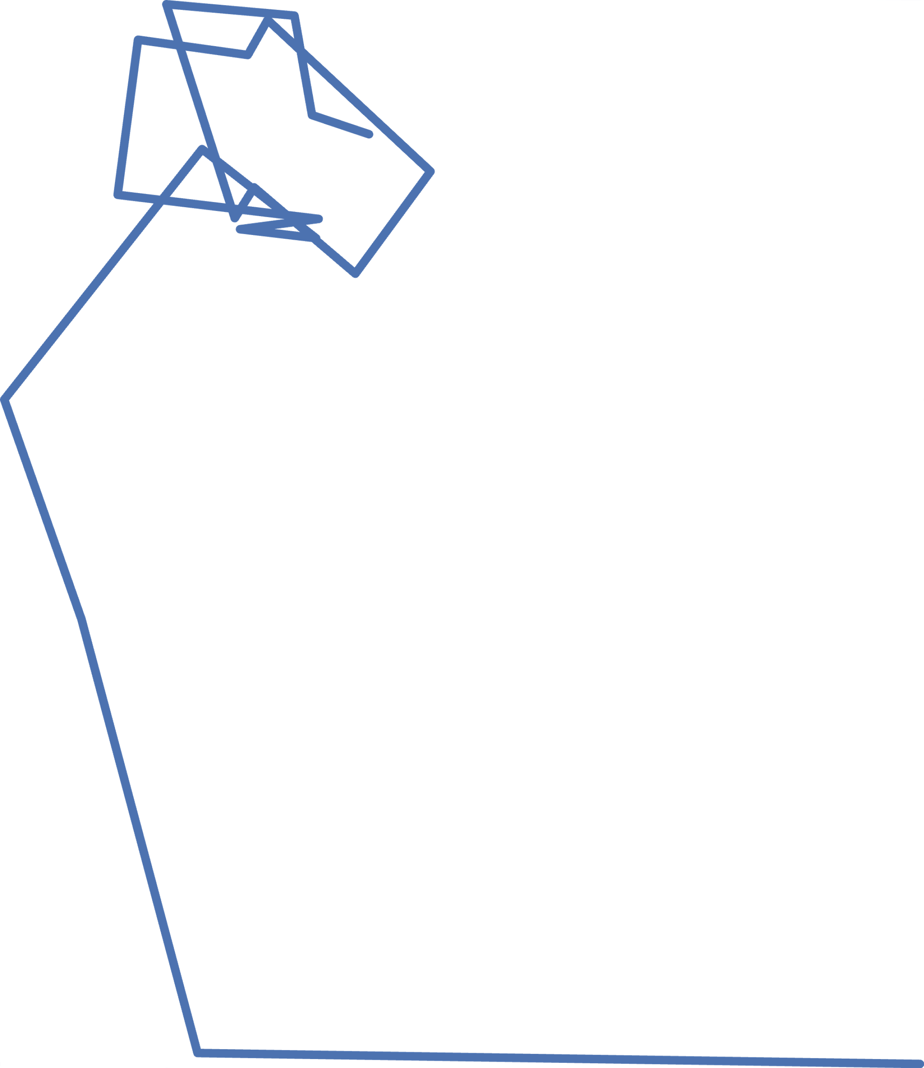
Template Matching
Template matching
Matched filter
Match /
No match
Input
Template
Matched filters enable us to perform template matching and detect qubit relaxations

Slide 38
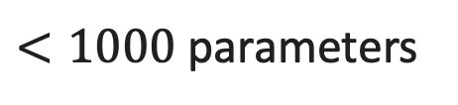
Relaxation Matched Filters
HERQULES
MF
Use traces corresponding to relaxations for
training Relaxation Matched Filters (RMF)
0 or 1?
MF
NN
RMF
Readout
Signal
0 - 31
RMF
$<1000$ parameters
True 0 or 1→0?
Satvik Maurya et al. “Scaling Qubit Readout with Hardware Efficient Machine Learning Architectures”, ISCA 2023
The RMFs are designed to detect the qubit relaxations

Slide 39
HERQULES Performance Overview
 | Baseline¹ | HERQULES
Qubit 1 | 0.969 | 0.985
Qubit 2 | 0.753 | 0.754
Qubit 3 | 0.943 | 0.966
Qubit 4 | 0.946 | 0.962
Qubit 5 | 0.97 | 0.989
Ƒ_{5Q} | 0.9122 | 0.9266
16% relative improvement
If an FPGA large enough to fit the baseline is used, HERQULES can fit the hardware required for readout of >10x more qubits.
HERQULES enables qubit state classification with greater accuracy

Slide 40
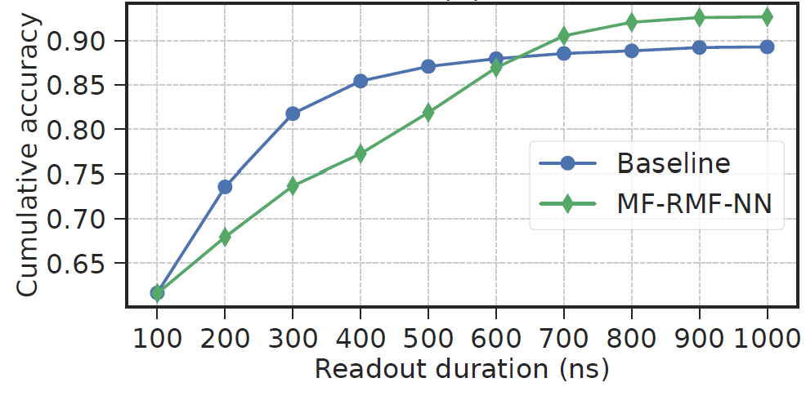
What About Latency Of Measurement Operations?
HERQULES can achieve higher readout accuracy with
a shorter readout duration without requiring re-training.
Fast and accurate readout at scale remains an open problem

Slide 41
Summary
Measurement errors can be reduced at the device-level, by performing measurements in a less vulnerable state, via device characterization followed by output post-processing, and by using enhanced classifier to classify the output states.
Measurement errors depend on the quantum state, we can transform a more vulnerable state into a less error-prone one before measuring.
We can assess the probabilities of incorrectly measuring each state as another via device characterization and use this information to rectify the output distribution. We can use measurement subsets and recompilation to further improve fidelity.
Readout errors happen due to qubits relaxing during these long-latency operations. We can detect them by designing more accurate classifiers to determine output states accurately.
Fast and accurate readouts are desirable, remains an open problem.

